Slide 1
Two Dimensional Algorithm Unit 2
Lecture 1

Slide 2
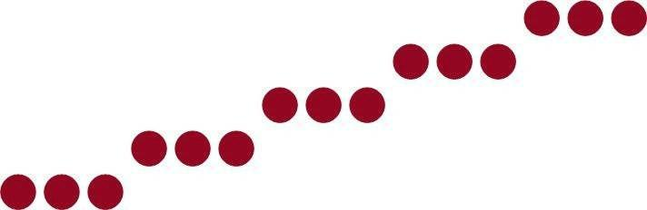
Points and Lines
Points
Plotted by converting co-ordinate position to appropriate operations for the output device (e.g. in CRT monitor, the electron beam is turned on to illuminate the screen phosphor at the selected location.)
Line
Plotted by calculating intermediate positions along the line path between two specified endpoint positions.
Screen locations are referenced with integer values, so plotted positions may only approximate actual line positions between two specified endpoints . E.g.: position (10.48,20.51) à (10,21).

Slide 3
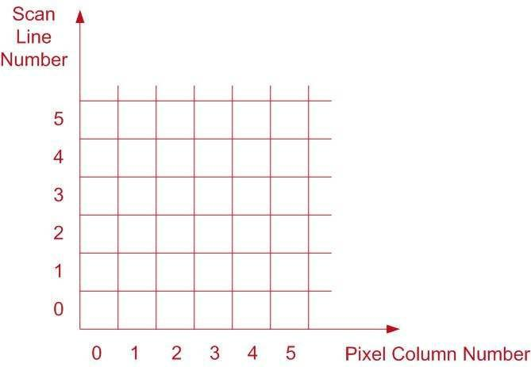
Pixel Position
Pixel position: referenced by scan line number and column number

Slide 4

DDA Algorithm
Digital Differential Analyzer
Scan-conversion line – algorithm based on calculating either
Sample the line at unit intervals in one coordinate
Determine the corresponding integer values nearest the line path in another co-ordinate

Slide 5
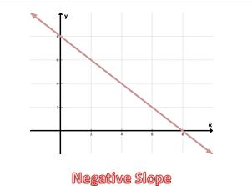
y
CASE 1
Positive Slope
(Y always increase when X increases and
Y always Decreases when X decrease)
CASE 2
Negative Slope
(Y always increase when X decrease and
Y always Decreases when X increases)
x

Slide 6
CASE 1
Positive Slope
Slope less than 1 ( |M| < 1 ) and moving Left to Right
^{X}k+1 = X_{k} + 1
Y_{K+1} = Y_{k} + M
Slope less than 1 ( |M| < 1 ) and moving Right to Left
^{X}k+1 = X_{k} – 1
Y_{K+1} = Y_{k} - M

Slide 7
Slope greater than 1 ( |M| > 1 ) and moving Left to Right
X_{k+1} = X_{k} + 1/M
^{Y}K+1 = Y_{k} + 1
Slope Greater than 1 ( |M| > 1 ) and moving Right to Left
X_{k+1} = X_{k} – 1/M
^{Y}K+1 = Y_{k} – 1

Slide 8
CASE 2
Negative Slope
Slope less than 1 ( |M| < 1 ) and moving Left to Right
X_{k+1} = X_{k} + 1 and Y_{K+1} = Y_{k} + M
Slope less than 1 ( |M| < 1 ) and moving Right to Left
X_{k+1} = X_{k} – 1 and Y_{K+1} = Y_{k} - M

Slide 9
Slope greater than 1 ( |M| > 1 ) and moving Left to Right
X_{k+1} = X_{k} – 1/M and Y_{K+1} = Y_{k} – 1
Slope Greater than 1 ( |M| > 1 ) and moving Right to Left
X_{k+1} = X_{k} +1/M and Y_{K+1} = Y_{k} +1

Slide 10
DDA Examples
Q.> Digitize a Line with end point A(2,3) and B(6,8) , using DDA.
A.> Here , Slope (M) = (8-3)/(6-2) = 1.25
Here Slope is positive and greater than 1 And moving left to right and 1/M = 0.8
So , we use
^{X}k+1 = X_{k} + 1/M
Y_{K+1} = Y_{k} + 1

Slide 11
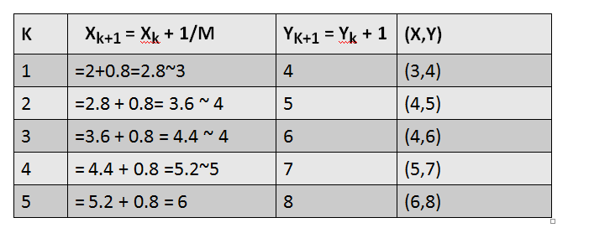

Slide 12
DDA Exercise
Digitize the line from A(1,1) to B(10,8) using scan conversion line algorithm.
Draw a line with two end point P(5,3) and Q(1,2) using DDA moving from Right to Left.
Digitize the line with endpoints A(1,7) and B(6,3) using digital differential analyzer line drawing algorithm. Show all necessary steps.

